Slide 1

Veterinary CARE
User Experience Design Project GANPAT UNIVERSITY, ICT
We care about your pet, We protect who need protection.
Group - 12
Juhi John (20162121006)
Krupal Patel (20162121007)
Manasvi Patel (20162121008)

Slide 2
INTRODUCTION
“Vet Care” is an application which is simple and easy to use. Users that are registered can send the symptoms of his pet/animal to the doctor and get responds. This application is useful for distant areas. Farmer has to register first and has to subscribe. Farmer will freely subscribe to Govt. CVHs.
The user has to pay fee if user will subscribe to the private clinic’s doctor. Animal Medical Veterinary Doctor App We are developing a system which is useful for layman.
“Vet Care” is an web application which is useful for users. Farmer has to set appointment for his pet. The doctor will receive the farmer’s requests and responds. The user’s data will be automatically added to the database. Farmer has to register first and has to subscribe.

Slide 3
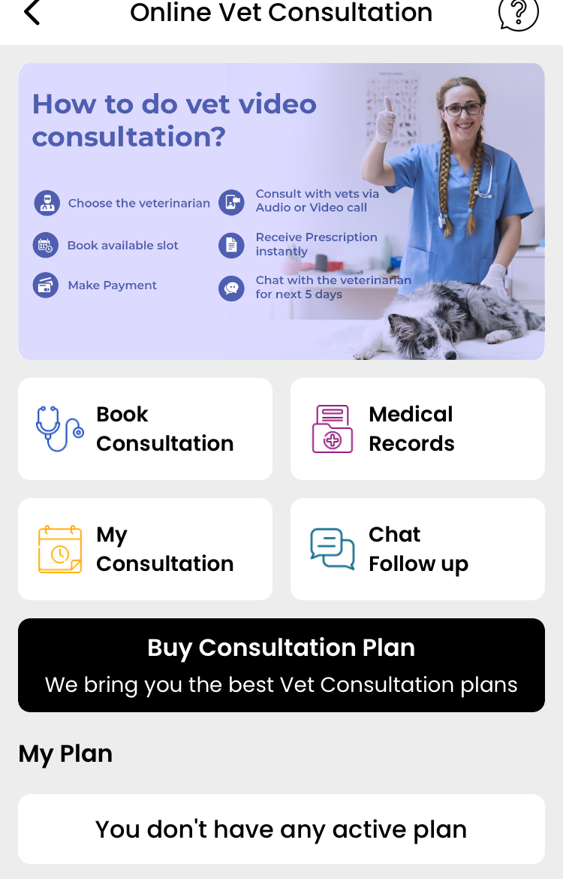
COMPETITIVE ANALYSIS
It provides Consultation, and stores your animals records
It have follow up the chat
Here we can also shop for pets
But you can’t add multiple pets.
Govt. doctors are not there so it’s paid

Slide 4
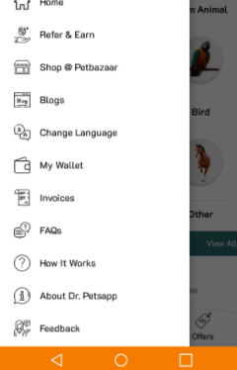
COMPETITIVE ANALYSIS
This are some menu options
In this my wallet is not so much use for villages as they will choose government doctor which is free of cost
In this there are so Menu options so person can get confused so we can limit it.

Slide 5
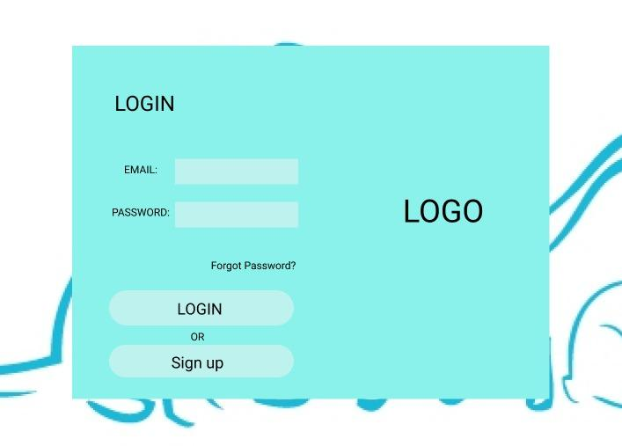
PROTOYPE

Slide 6
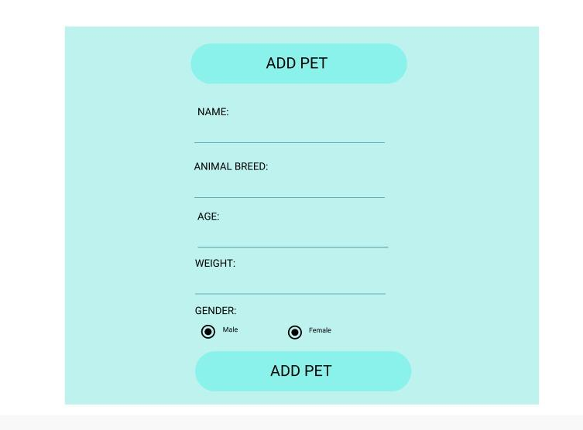
PROTOYPE

Slide 7
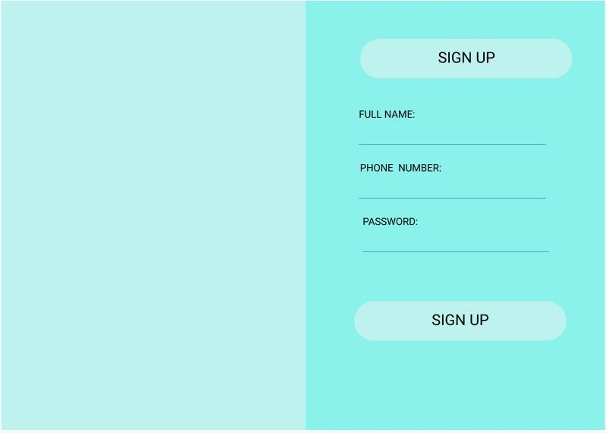
PROTOYPE

Slide 8
METHODOLOGY
Design
Creating templet
Checking for missing points
Proper UXD usage
Implementation
As Web Application
Implementing using HTML, CSS
Adding backend
Connecting with database
User Person
Feedback
Taking Feedback
Changing requested changes

Slide 9
METHODLOGY
Main home page
Login page, if not registered then register and then login
Dashboard (Add pet, Set appointment, Show pet details, Show appoinments, Check medical records)

Slide 10
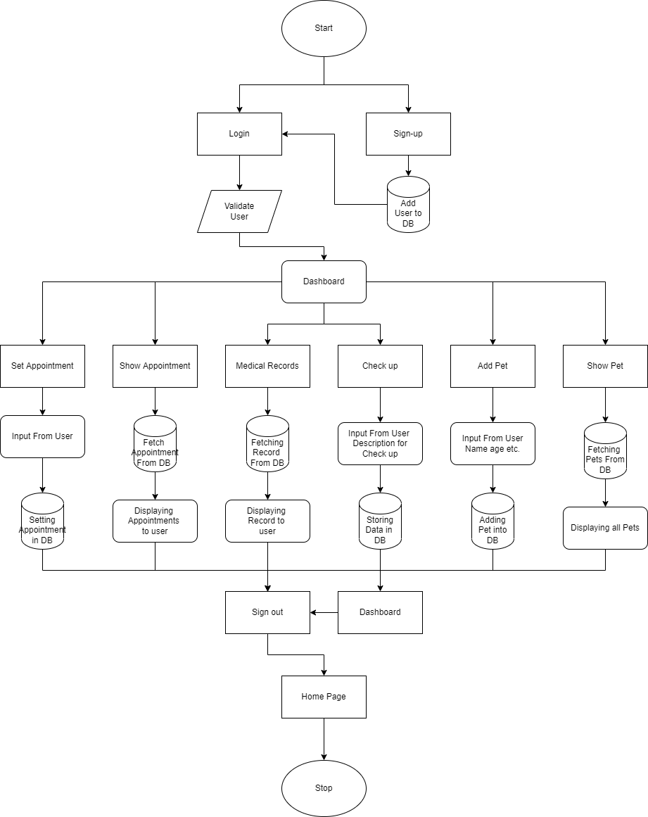
FLOW CHART

Slide 11
TOOLS AND TECHNOLOGY
SOFTWARE:
Figma
Eclipse
TECHNOLOGY:
HTML
CSS
MySQL
JSP
JAVA

Slide 12
CONCLUSION
This application will help villagers to over come there problems for there animals / pets for free if they use Government doctors.
It will also help them to overcome problem of taking animals / pets to nearby vet care centre.
It also helps people to get pets / animals need online in this pandemic time.

Slide 13
Thank You

